Slide 1
B
B
QHE
QHE
QSHE

Slide 2
A
B
C
D

Slide 3
A
B

Slide 5
A
B
C
D

Slide 6
E
B

Slide 7
A
B

Slide 8
A
B

Slide 9
A
B

Slide 10
Pin Connection
Measurement
Probe
Paired Wires
Liquid
Nitrogen
Liquid
Helium
Liquid
Helium
Vacuum
Vacuum
Superconducting
Magnet
Sample

Slide 12
Wires

Slide 13
A
Wires
B
Sample
Contact
Pads

Slide 15
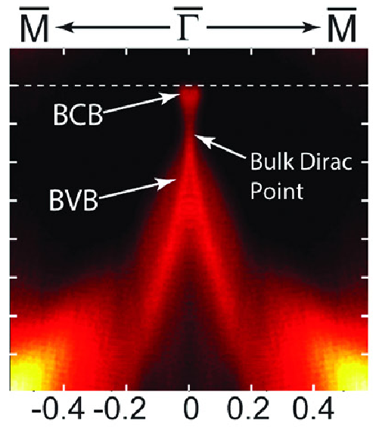
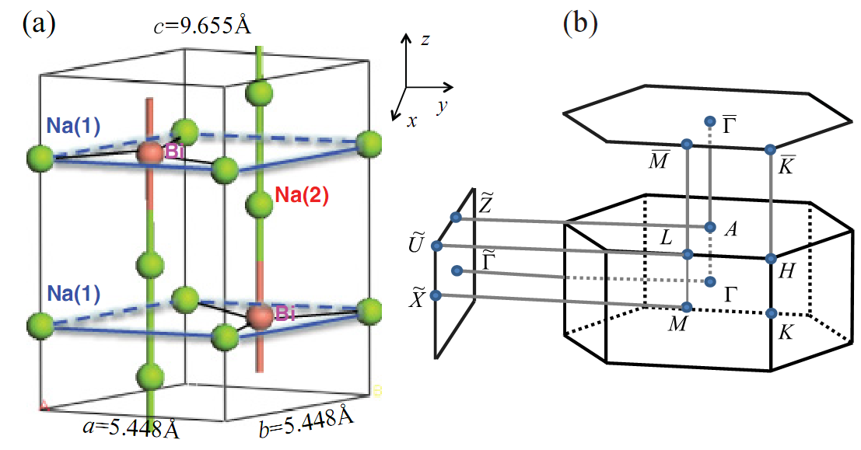
A
B
C
D

Slide 16
A
B

